Slide 1


Slide 2



Slide 3


Anonymice
Protector of Privacy, Guardian of the Small Folk
Zero-Trust Intelligent PII Anonymization & Reversible Redaction for LLM Workflows.

Slide 4




THE PROBLEM
Unintentional Data Leaks to Cloud LLMs
Exposed Identity Records
Unstructured text exposes names, emails, and credentials.
Compliance Penalties
GDPR and HIPAA strictly penalize unmasked cloud transfers.
Employees routinely paste sensitive documents into AI prompts.

Slide 5






THE SOLUTION
Zero-Trust Intelligent Anonymization
Contextual Redaction
Reversible Mapping
Local Execution
Instant entity detection for sensitive personal data.
Secure cryptographic key mapping for output restoration.
Zero external server calls or cloud dependencies.

Slide 6








ARCHITECTURE
How Anonymice Secures Your Data Pipeline
Named Entity Detection
Local Restore
Raw Input
Safe LLM Pass
Parse raw text documents locally.
Identify entities with regex & external models.
Send encoded prompts to cloud models.
decode responses automatically on device.

Slide 7
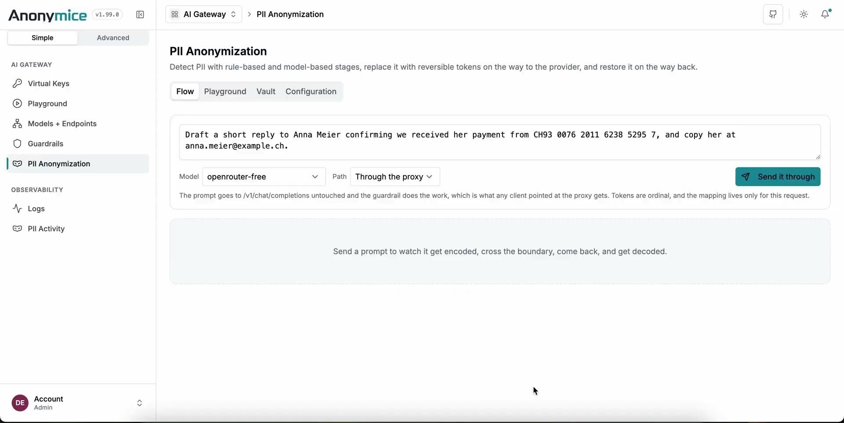

Slide 9




ARCHITECTURE
How Anonymice Secures Your Data Pipeline
piiranha 42.9% (local)
presidio (de) 86.2%
KEY TAKEAWAY
97.9%
privacy-filter 86.8% (more GPU)
Combined Multi-Detector Recall
privacy-filter + presidio 94.7%
Single detectors leave critical privacy gaps. Combining models achieves near-total PERSON entity capture across unstructured text.
all three (Anonymice Ensemble) 97.9%

Slide 10



GET STARTED
Secure Your AI Workflows Today
Open-source privacy protection built for modern enterprise pipelines.
We'd Love to Have You On Board!
ma-abdellaoui.github.io/anonymice
Share & Star
JOIN THE MISSION

